Slide 1

https://www.uni-goettingen.de/en/48115.html
Unless I explicitly state otherwise, images and cartoons are created using ChatGPT.
You may use this material free of charge under the terms of the CC BY license. This requires that you provide appropriate attribution to the author: W. Link, University of Goettingen, Germany.
In a few cases, individual images, photographs, or similar material may be subject to a more restrictive Creative Commons license. Where this applies, it is explicitly indicated, and you must comply with the stated license terms for those items.
Please check the license information carefully before reuse. Responsibility for complying with the applicable license terms rests entirely with you.
Chapter 13 of <Breeding Method>
UNPLAB-BrMeth_Ch13[TheFour V]

Slide 2
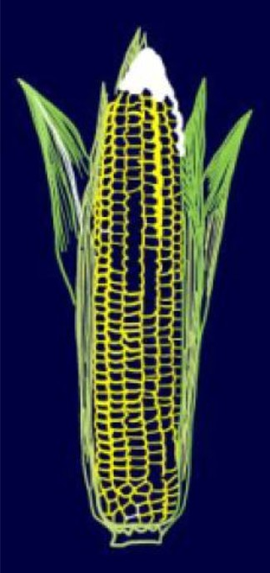
Sequential Number: #31
UNPLAB-BrMeth_Ch-13[TheFour V]
Still … Hybrid Breeding
https://s.gwdg.de/LQAu7K
© Mila Tost
2

Slide 3
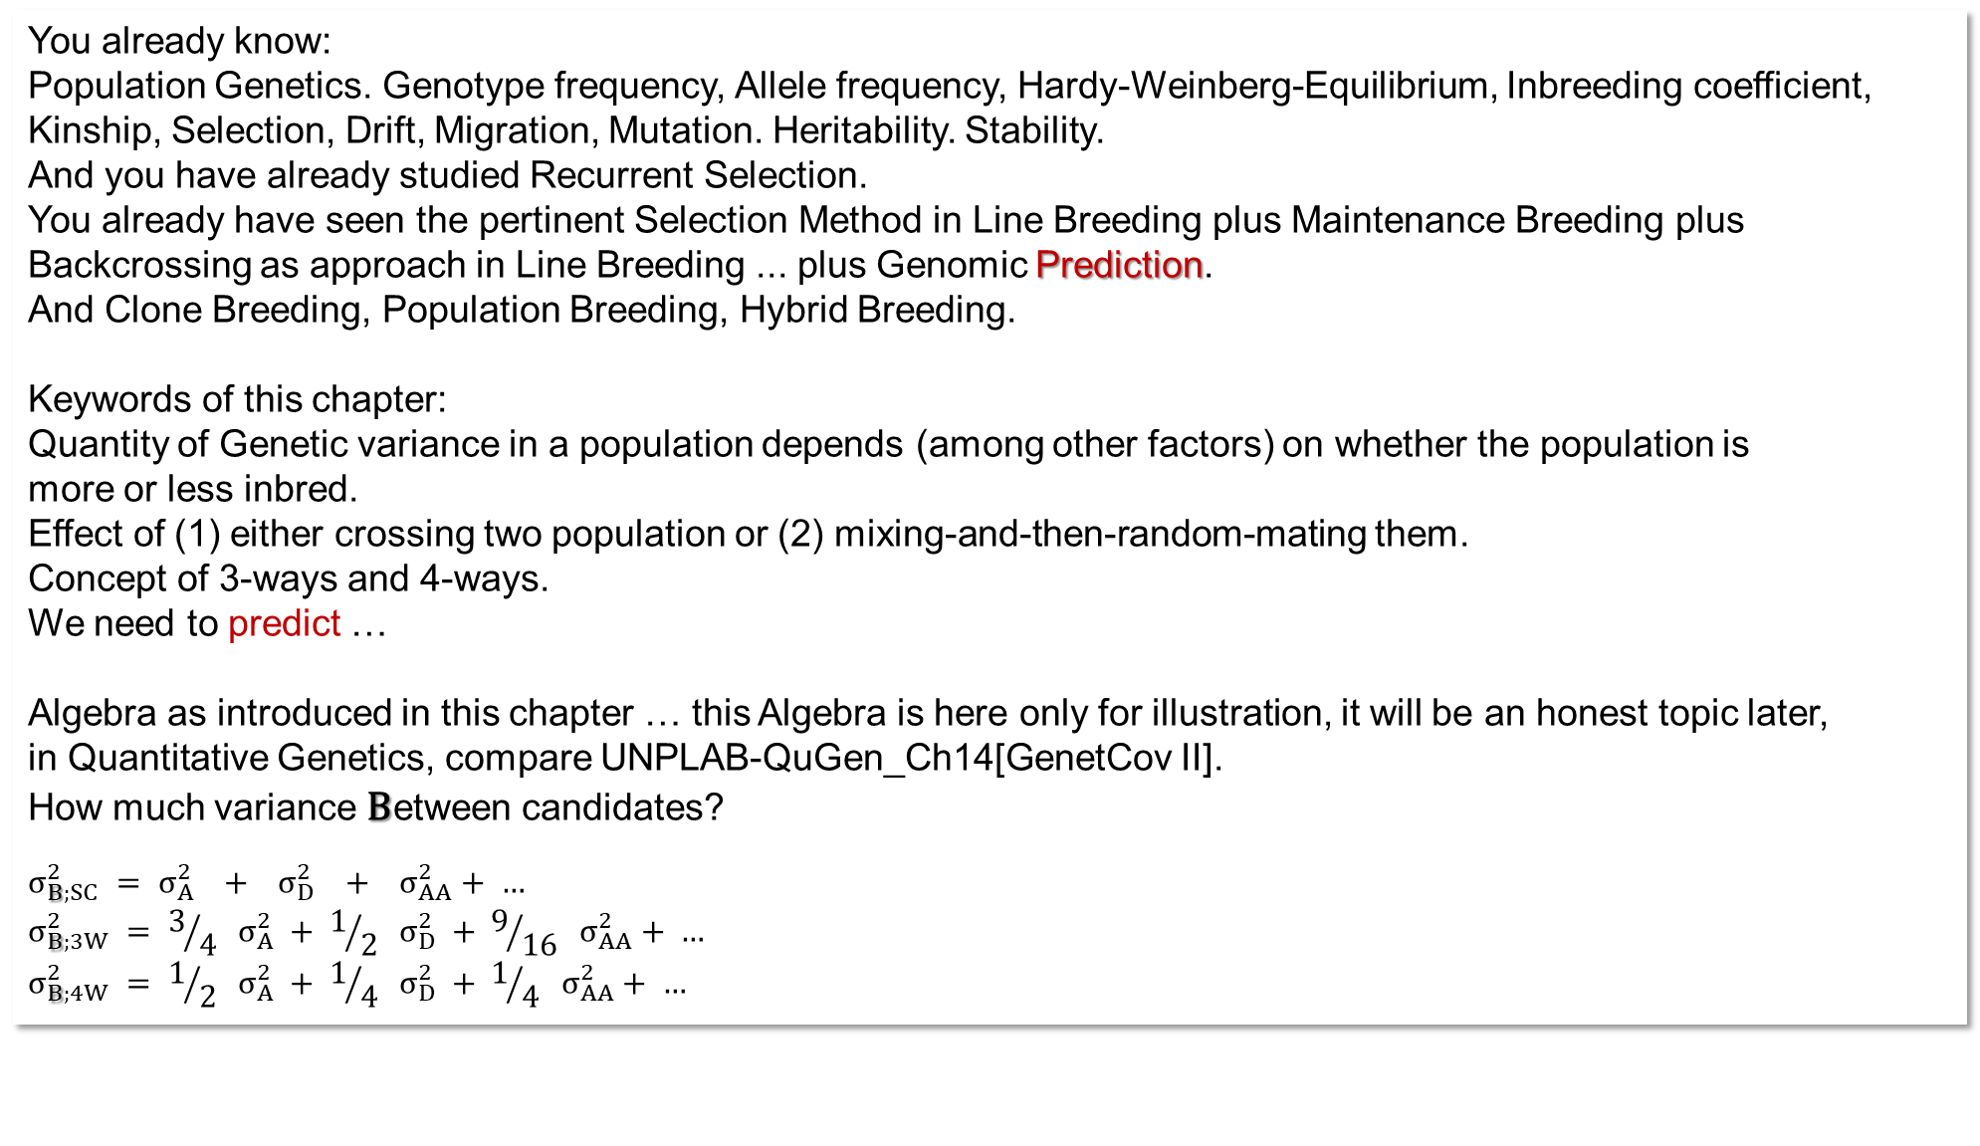
You already know:
Population Genetics. Genotype frequency, Allele frequency, Hardy-Weinberg-Equilibrium, Inbreeding coefficient, Kinship, Selection, Drift, Migration, Mutation. Heritability. Stability.
And you have already studied Recurrent Selection.
You already have seen the pertinent Selection Method in Line Breeding plus Maintenance Breeding plus Backcrossing as approach in Line Breeding ... plus Genomic Prediction.
And Clone Breeding, Population Breeding, Hybrid Breeding.
Keywords of this chapter:
Quantity of Genetic variance in a population depends (among other factors) on whether the population is
more or less inbred.
Effect of (1) either crossing two population or (2) mixing-and-then-random-mating them.
Concept of 3-ways and 4-ways.
We need to predict …
Algebra as introduced in this chapter … this Algebra is here only for illustration, it will be an honest topic later,
in Quantitative Genetics, compare UNPLAB-QuGen_Ch14[GenetCov II].
How much variance Between candidates?
$$σ_{B;SC}^{2} = σ_{A}^{2} + σ_{D}^{2} + σ_{AA}^{2}+ …$$
$$σ_{B;3W}^{2} = 3/{4 } σ_{A}^{2} + 1/{2 } σ_{D}^{2} + 9/{16 } σ_{AA}^{2}+ …$$
$$σ_{B;4W}^{2} = 1/{2 } σ_{A}^{2} + 1/{4 } σ_{D}^{2} + 1/{4 } σ_{AA}^{2}+ …$$
3

Slide 4

Imagine a Breeding Population: For the focal trait it has 200 segregating loci (two alleles each). Throughout, favourable allele is dominant and has frequency of p=60%. Favourable allele (A) ‚donates‘ an impact of +1 to the trait expression, unfavourable allele (a) donates zero. No linkage among loci, LD=0. Best genotype hence ‘is’ 200.
If the population is in HWE, then the probability to be AA (or Aa or aa) at the first locus is P=p²=36% (or H=2pq=48% or Q=q²=16%). The same is true for the second locus, the third, each other locus. A typical member of that HWE population is – on average and as expectation – homozygous for the dominant allele at 36% of the 200 loci. !!!
168
4

Slide 5
Imagine a Breeding Population: For the focal trait it has 200 segregating loci (two alleles each). Throughout, favourable allele is dominant and has frequency of p=60%. Favourable allele (A) ‚donates‘ an impact of +1 to the trait expression, unfavourable allele (a) donates zero. No linkage among loci, LD=0. Best genotype hence ‘is’ 200.
If the population is in HWE, then the probability to be AA (or Aa or aa) at the first locus is P=p²=36% (or H=2pq=48% or Q=q=16%). The same is true for the second locus, the third, each other locus. A typical member of that HWE population is – on average and as expectation – homozygous for the dominant allele at 36% of the 200 loci. !!!
You see the point. Not only is p²+2pq+q² describing the frequency of individuals being either AA or Aa or aa. But, here, with all loci having same allele frequency, p²+2pq +q² is as well describing the expected frequency of loci being homozygous-dominant, heterozygous, homozy-gous-recessive (in a typical, average-case individual).
5
In HWE, here, the average-case individual is either ho-mozygous-dominant (36%) or heterozygous (48%) at 36 + 48 = 84% of the 200 loci, making a total of 168 loci. These contribute +1 per locus, and the missing 32 loci (16%) contribute zero per locus.
The mean of the HWE population is, therefore, 168.
168

Slide 6
Population: 200 segregating loci (two alleles each). Throughout, favourable alleles are dominant, ‘their’ p=60%, and they ‘give’ +1 (unfavourable alleles ‘give’ 0). LD=0.
What is the genetic variation between the HWE individuals? The average plant’s ‘value’ is 168, but some are higher, some are lower. 200 loci is as sample size limited, the genotype usually deviate from „168 vs. 32“. Per locus, the probability to have +1 is 0.84 (from either ‘like AA’ or ‘like Aa’); to have 0 is 0.16 (‘like aa’). Per locus, following the Binomial Algebra (https://s.gwdg.de/zrZYGE), variance is 200∙0.84∙0.16 (‚σ²=Npq‘). This results in σ²=26.88 and σ=5.185. Quantitative Genetics (employing a=d=½) would have written: σ²_{G}=σ²_{A}+ σ²_{D} = 2pq[a-(p-q)d]²+(2pqd)² = 15.36 + 11.52 = 26.88; same result in a more complicated ;-) way. See UNPLAB-QuGen_Ch8[Decomp-GenV I].
The shape of the normal distribution which here is nicely approximating the binomial distribution tells: To get a genotype with value of – for instance ... 168+2∙5.185 = 178.37 or higher, we must select the 2.3% best indi-viduals (‚Selection Differential‘, see UNPLAB-h²_GxE_Ch-5[BreedersEquation]).
We can check this with the Binomial algebra. With our 84% and 16% probabilities, we find that individuals with at least 178 loci ‚good‘ occur in 2.9% of cases and those with at least 179 loci ‚good‘ in 1.8% of cases, fitting well with our normal distribution approximation.
What is the best-possible genotype? The one which has at each locus the ‚good‘ allele at least heterozy-gously. What is the probability of finding it?
A plant which is ‚good‘ at one locus has 84% probability. A plant which is ‚good‘ at two loci simultaneously has 0.84² (= 70.56% frequency).
The desired genotype occurs with 7.1756∙10⁻¹⁶;
like 1.4 in a quadrillion.
168
178
200
6

Slide 7
Population: 200 segregating loci (two alleles each). Throughout, favourable alleles are dominant, ‘their’ p=60%, and they ‘give’ +1 (unfavourable alleles give 0). LD=0.
The red curve on the left: What is it?
We need some imagination. We ‘convince’ our HWE population to abandon its usual Random Mating and, instead, undergo many generations of Self-Fertilization, until all plants then are homozygous (of course, you know, no Selection-Mutation-Drift-Migration). Still, p(A)=60% at each locus, so p(A)=p(B)=p(C)= et cetera. If no heterozygosity exists any more, then all loci are homozygous, either AA or aa (either CC or cc et cetera).
The average individual then shows, at the first locus, AA with P=0.6 and aa with Q=0.4 (and, of course,
Aa with H=0.0). Same for each other loci. Hence, the average plant has the +1-contribution at 60% of the 200 loci, this is 120 loci, therefore the mean of this now-homozygous population is 120.
By the way, the difference between 168 and 120 is the average of all Heterosis values of all the (non-inbred) members of the HWE population (= mean heterosis of all F1 from all homozygous pairs that exist in red).
The average heterosis is, hence 48.
Seemingly the variation under the homozygous-plants‘ curve is wider. It is 200∙0.6∙0.4 (‚σ²=Npq‘). This results in σ²=48 and σ=6.928. This the additive variance at homozygosity (it is, btw, not the additive variance we saw in the last page in HWE (having been σ²_{A}=15.36). ... More in UNPLAB-QuGen_Ch-10[GenV 0_F_1].
Mean heterosis
120
168
7

Slide 8
What is my (I mean, our) reason to study this here?
The black curve shows the genetic diversity in HWE four our trait. All plants were created from the mating of two ge-netically unrelated gametes (egg-cell, pollen grain). Each member in HWE is a hybrid, just being unique (instead of being one of many members of a uniform, non-segregating Mendelian F1-generation). Why unique? Because the egg-cell was unique, because the pollen grain was unique (cf. UNPLAB-PopGen_Ch-2[HWE II] pages 16, 17).
We could change this unique-ness of (mother-derived and father-derived) gametes. Instead of mating these two gametes, we could ‚take‘ them and transform them, convert them into two DH-lines. Then we could cross these two DH-lines and re-create the very same hybrid (the very same member of HWE population) – just that we could now pro-duce a rather unlimited number of individuals of that same hybrid genotype.
We would have, instead of an annual, mortal, unique member of HWE, now a reproducible hence immor-tal member of HWE (since the parents, being homozygous lines, can be seen as immortal genotypes and as immortal producers of identical gametes).
168
8

Slide 9

What is the reason to study this here?
Could we, in case we identify the best or, say, a very good individual in a population: could we not ‚just‘ take it and multiply it via selfing and thus produce an outstanding cultivar?
We could: If the trait is with little or no Inbreeding Depres-sion (little or no Heterosis); if the trait was like oil quality in sunflower. We may find many cases in breeding orna-mental plants, where ‘beauty’ might be non-heterotic.
But if it is yield, then there will be Inbreeding Depression and … well, what-then, after the selfing?
A population
We end up with S1-lines (i.e. F2-families) from HWE members). Doing so with all HWE individuals, we sacrifice half of their heterosis.
The mean of all-these F2 families would be 168-(48/2) = 144*.
*’Simple’ genetics assumed!
HWE, non-inbred
9
Half-inbred
Even the most superior members of this half-inbred population of S1-lines (F2-families) will never make it as ‚improved‘ population. They barely reach a value up to 168 in our example and certainly not beyond. Alas.
We are reminded of the - in the case of population varieties – indissoluble, inextricable connection between genetic breadth in this generation and the inbreeding in the next generation.
Inbred
120
144
168

Slide 10

Here the take-home message
Hybrid Breeding in cross-fertilizers is not because we want heterosis to be realised; heterosis is realised in populations any-way.
Hybrid breeding is successful because we can cherry-pick a single, outstanding hybrid genotype and mass-produce seed for just this unique type (make it immortal). Not by vegetative propagation, that would be clone breeding;
but by maintaining and mass-propagation its female and male (homozygous, non-segregating) parents.
Selection intensity is extremely high in hybrid breeding: Just one genotype makes the cultivar. This is a reason to go for hybrid breeding; for its success story.
And this strict selection is no option in Population Breeding, because of the threat of inbreeding depression there.
A population
168
10

Slide 11
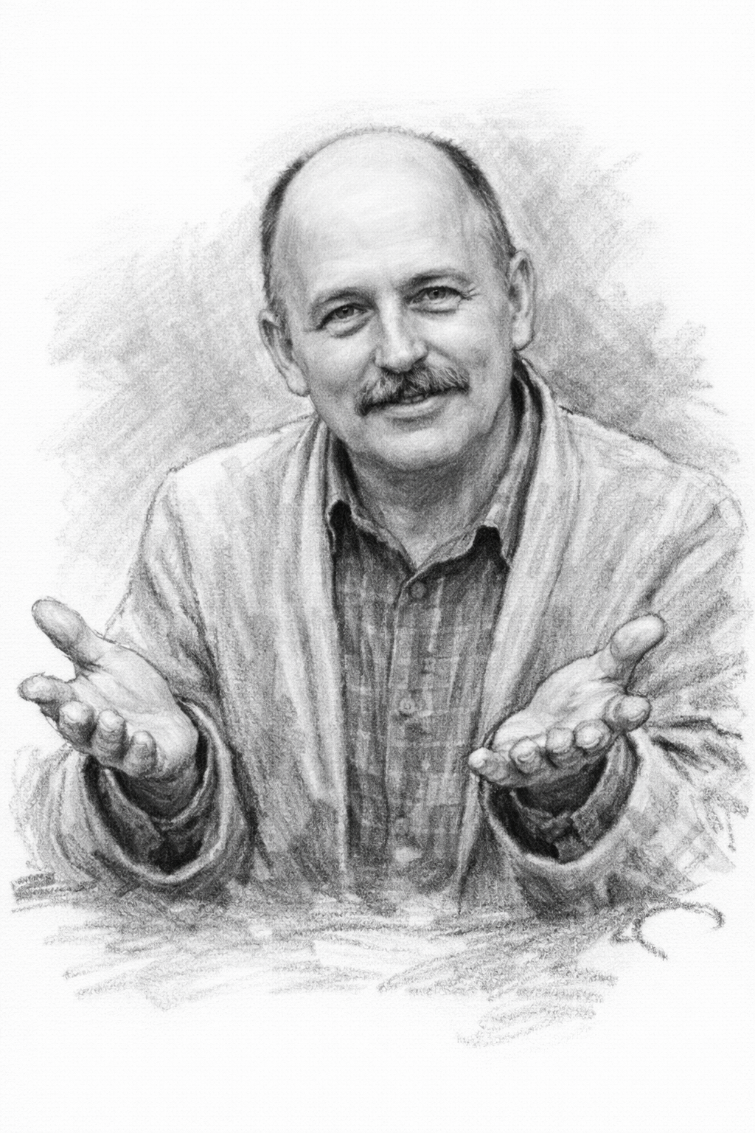
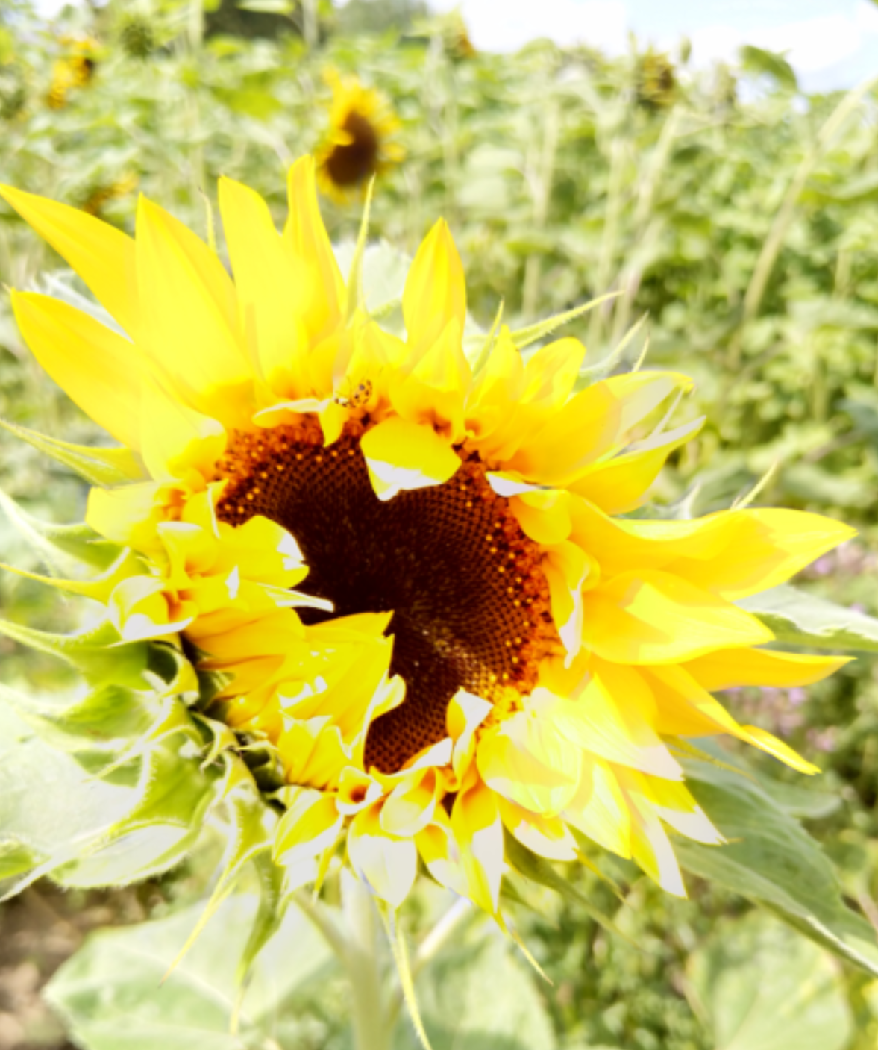
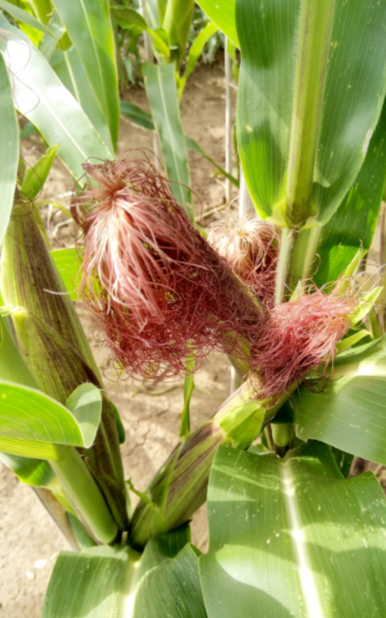
But what about Heterosis, don’t we increase Heterosis if we select for the best F1’s ?!
Answer is at the bottom of next page.
Welcome gesture
Yes, of course, the best genotype that will be selected with this extremely strict selection is expectedly realising a higher Heterosis than average, and at the same time a higher than average (homozygous) Parental Mean; otherwise such genotype would have hard times to be the best one.
How do Parental Mean and Heterosis jointly impact performance as we select for maximum performing F1 hybrids?
Quantitative Genetics may bring some enlightenment to this, it may help us to better discuss these topics; UNPLAB-QuGen, Ch-1 to Ch-14.
© W Link ... © Mila Tost ... © W Link
11

Slide 12
Simplified assumptions: a=d=1, zero Epistasis. For the polygenic perspective, take LD=0. We are getting ahead of ourselves - for this page; as if we've already covered up to UNPLAB-QuGen_Ch9[Decomp-GenV II].
12
1.0
0.7
0.5
0.25
0.0
The correlation r between Parental Mean and F1-performance depends on the ratio σ²_{D} to σ²_{A}. Breeding values (~GCA) are (highly) correlated with Parental Mean; Dominance Deviations (~SCA) aren’t. The higher the ratio σ²_{D} / σ²_{A}, the smaller is r . The diagram has it. With p ≥ 2/3, σ²_{D} ≥ σ²_{A}; r = 1/2^{0.5} there; with p=6/7, r=0.5; and r=0.25 with p=30/31. In this region of p(A1), it is the exploitation of σ²_{D} rather than of σ²_{A} that allows for some (limited) further gain from selection. The contrary is true for p<2/3, when we see a high r between parental mean and F1-perfor-mance and there, it is mainly the additive share of the variance that determines what happens (cf. Wricke and Weber 1986; Schnell and Geiger, 1978).
a=d=1
p(A₁)=2/3
σ²_{A}
Correlation
r
Size of variance in HWE conditions
Correl. between parental mean and F1
σ²_{G} =
σ²_{A} + σ²_{D}
σ²_{D}
0.0
0.1
0.2
0.3
0.4
0.5
0.6
0.7
0.8
0.9
1.0
p(A1)
Except at very elite level (p>2/3), gain from selection for F1 performance is driven by exploitation of differences bet-ween inbred lines (and correlated GCA effects) rather than by differences between dominance (~heterotic) effects.

Slide 13
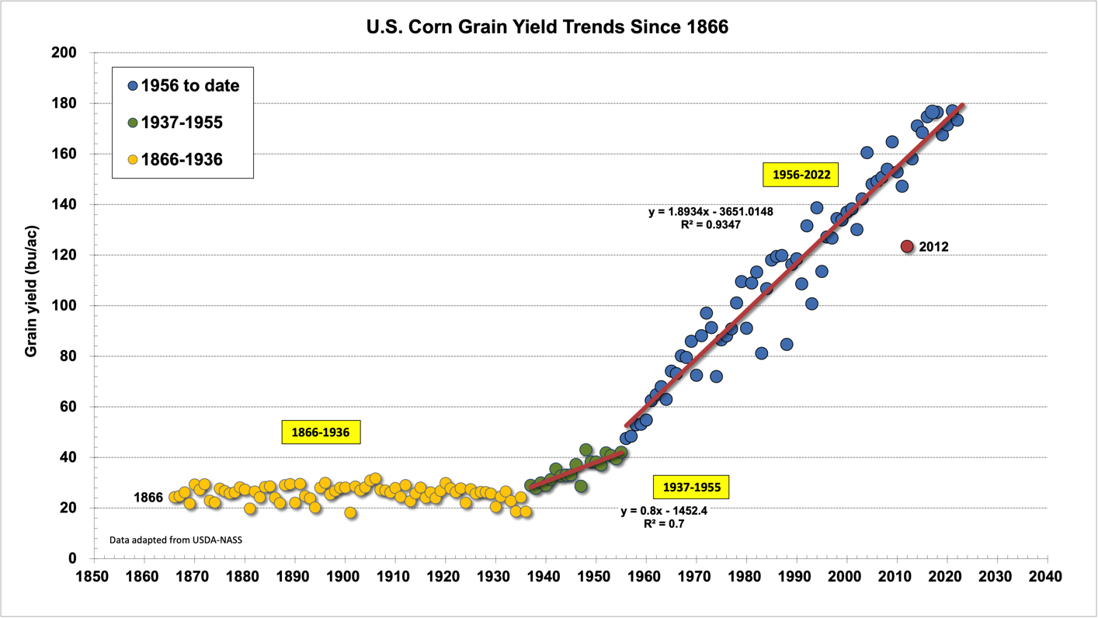
After ~1940, Population Breeding in maize was replaced by hybrid breeding:
First by 4-way cross hybrids (doubles), then by single-cross hybrids.
Single-cross hybrids were bred as soon as better-yielding inbred lines were developed.
Inbreeding depression was reduced by breeding, pro-bably via purging the germ-
plasm from semi-
lethal and lethal re-
cessive alleles.
Yield increase of inbred lines across decades of breeding was slightly more pronounced than yield increase of their hybrids.
Single cross hybrids.
Slope = 1.89; R²=0.935
Drought stress season
Population cvs.
Double cross hybrids
http://www.kingcorn.org/news/timeless/yieldtrends.html
13

Slide 14
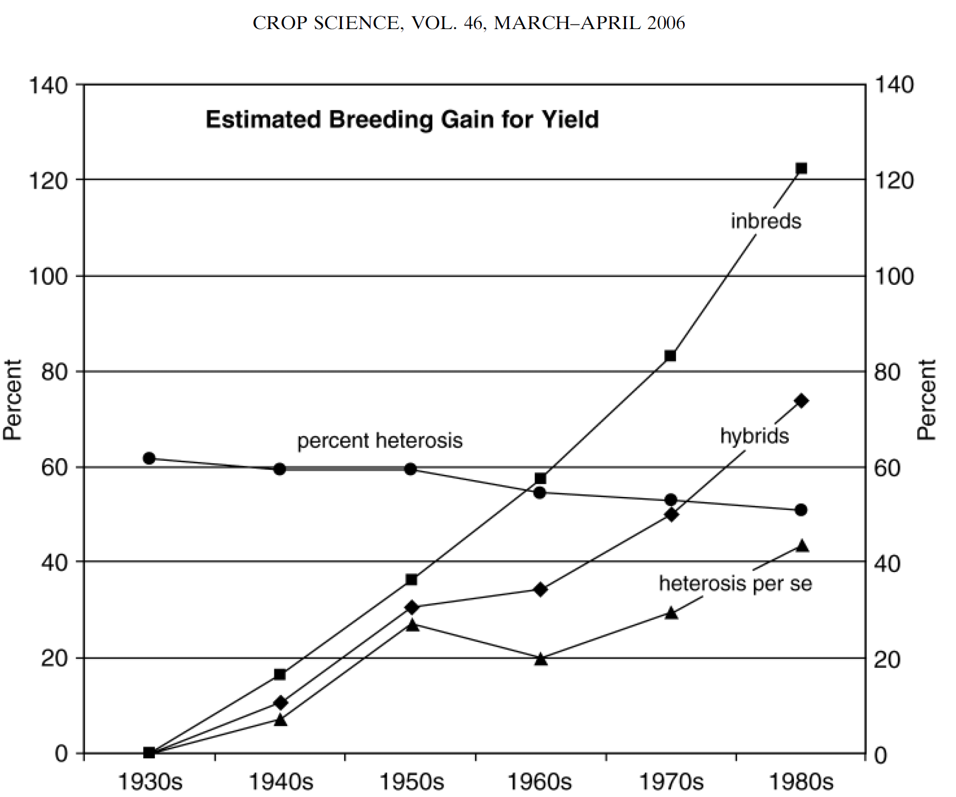
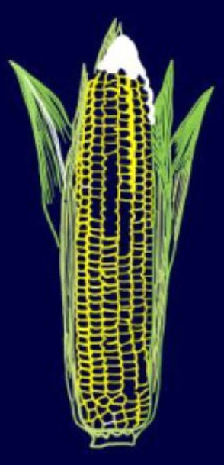
Troyer, 2006: Adaptedness and Heterosis in Corn and Mule Hybrids.
Crop Science 46: 528-543.
Observe yield of single-cross hybrids, their inbred parents, and heterosis over six decades in percentage of 1930 values. Percentage of heterosis in actuals values for each decade. From Duvick, 1999. Heterosis: Feeding people and protecting natural resources. p. 19–29. In J.G. Coors and S. Pandey (ed.) The Genetics and Exploitation of Heterosis in Crops. ASA, Madison, WI.
Heterosis (expressed in %) seems to decrease
across these 50 years whereas the performance of the inbred parents increased, and even more than the perfor-mance of their hybrids. Of course, management in 1980 was different from 1930 - the later bred cultivars should be better adapted to the more ‘recent‘ settings. And be aware that heterosis is in %, the inbreds’ increase is measured versus a lower performance than the hybrids’ ... hm hm hm .
Generally, the impression is that the homozygous performance which is free from dominance effects is the main driver of increased yield of maize hybrids. This is slightly counter-intuitive, since the grand narrative of hybrid breeding is heterosis (presumably based on dominant-recessive gene action).

Slide 15
We now compare two scenarios.
Either we (1) cross two population -
this is mimicking the basic approach of Hybrid Bbreeding
or we (2) mix two populations and-then-random-mate them -
This is mimicking the basic approach of Population Breeding.
We focus on the question when and how and why we are seeding different outcomes for ‘use of heterosis’
15

Slide 16
We cross two populations (they differ in allele frequency). We study allele and genotype frequencies and impact on heterozygosity and heterosis.
Genotype ► Impact on Trait : AA ►1.0 Aa ►1.0 aa ► 0.0
Population 1 with allele frequency 60% for the A allele. Hence, heterozygosity = 2pq = 48%.
Population 2 with allele frequency 40% for the A allele. Hence, 2pq = 48%. Δp(A) = 0.6 - 0.4 = 0.2
Mixing the two populations gives allele frequency 50% for the A allele and in the new HWE then: 2pq = 50%.
Crossing the two populations gives (see below): Heterozygosity of (36% + 16%) = 52%.
The increase in heterozygosity (ΔH=4%=0.04) reflects the allele frequency difference: ΔH=(Δp²)=0.2²=0.04
in the new HWE
Population 2
µ=0.64
This case is not very thrilling, because the performance of population 1 is larger than the performance of the ‘hybrid’ population: 0.84 > 0.76.
Population 1: Performance µ = p‘² ∙ 1.0 + 2p‘q‘ ∙ 1.0 = (0.36+0.48) =0.84
Population 2: Performance µ = p‘‘² ∙ 1.0 + 2p‘‘q‘‘ ∙ 1.0 = (0.16+0.48) =0.64
Hybrid population: Perf. µ = (p‘q‘‘ + p‘p‘‘ +q‘p‘‘) ∙ 1.0 = 0.36+0.24+0.16=0.76
The performance of the hybrid population is – yet – higher than the mean of the two parental populations (their mean performance is 0.72).
But: See next page, when we go from monogenic to polygenic.
a
q‘‘=0.6
A
p‘‘=0.4
Aa
0.36
1.0
AA
0.24
1.0
A
p‘=0.6
Population 1
µ=0.84
aa
0.24
0.0
Aa
0.16
1.0
a
q‘=0.4
16

Slide 17
We compare two ‘parental’ populations and the outcome from either mixing them or crossing them (crossing is the perspective of Hybrid Breeding, although here, the parents are not ‘homozygous inbred lines’). The parents differ symmetrically for ‘good’ alleles ...
Hybrid breeding ≠ Hybrid seed production. Hybrid seed production was, in the beginning, a nightmare. Inbred lines that should produce hybrid seed suffered so badly from inbreeding depression - they oftentimes did not survive the inbreeding at all.
At these times (~1950), instead of using two inbred lines to produce a hybrid, the mother (and even the father) of the hybrid seed first had to be non-inbred; so that the parents of certified seed could achieve a reasonably high-yielding crop and a good income for the seed-producing farmers.
Of course one could have used one popula-tion cultivar as mother and a different one as father. If the populations are genetically dif-ferent from each other, then this results in a higher heterozygosity and hence a certain heterotic increment compared to ‘mixing the two populations and allow the mixture to randomly mate’ – to produce farmers’ seed.
See here just Population 1, Population 2 is added next page
Two populations, both in HWE.
►Either mix them 1:1 and via random mating, the joint population gets its new HWE.
►Or cross them (all intra-population crossing is avoided) to create a Pop1 x Pop2 –hybrid.
The two initial populations have same heterozygosity and performance. They differ symmetrically for frequency of ‘good’, dominant allele.
Pop1 has more good alleles at loci 1-100
Pop2 has more good alleles at loci 101-200.
Locus 1 until 100
Locus 101 until 200
17

Slide 18
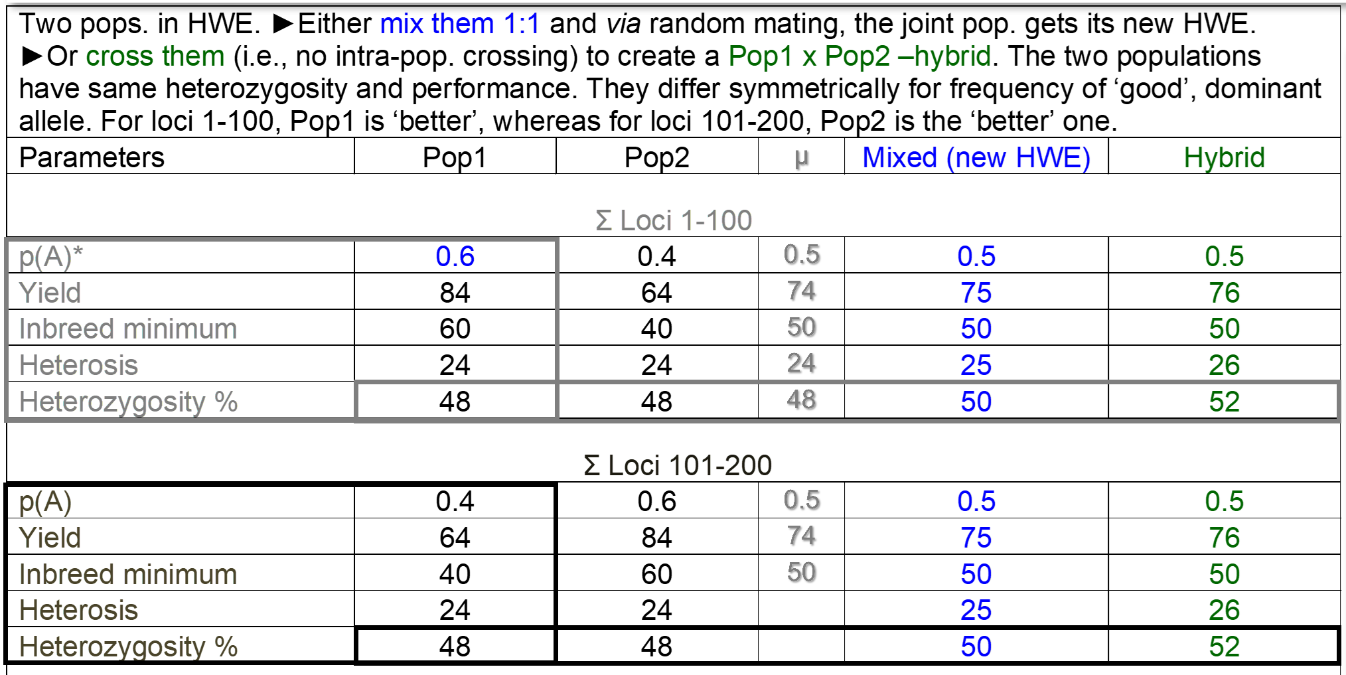

Slide 19
We compare two ‘parental’ populations and the outcome from either mixing them or crossing them (crossing is the perspective of Hybrid Breeding, although here, the parents are not ‘homozygous inbred lines’). The parents differ symmetrically for ‘good’ alleles ...
At these times (~1950), instead of using two inbred lines to produce a hybrid, the mother (and even the father) of the hybrid seed first had to be non-inbred; so that the parents of certified seed could achieve a reasonably high-yielding crop and a good income for the seed-producing farmers.
Of course one could have used one population cultivar as mother and a different one as father. If the populations are genetically different from each other, then this results (our case now) in a higher heterozygosity (52>50>48) and hence a certain heterotic increment compared to mixing the two populations and allow them to randomly mate.
19

Slide 20
Similar but: Less symmetrically hence higher ‘effect’ (64 + 16 = 80; 72 + 8 = 80).
The average performance of the two parental populations is 64 yield-units, they perform identically. After mixing they reach their new HWE a yield increases to 72, this is because hetero-zygosity increased and, with constant minimum performance at homo-zygosity, heterosis increased.
Producing a hybrid, i.e. a controlled cross between the two populations, would increase heterozygosity even further, the increase is doubled now, the performance increases accordingly
80 > 64).
To cross two populations is a waste of opportunities. Both populations contain inferior types that should not participate in the crossing. Hence, the idea of 4-way hybrids and of 3-way hybrids emerged (parents narrower, more ‘selected’, more ‘elite’).
20

Slide 21
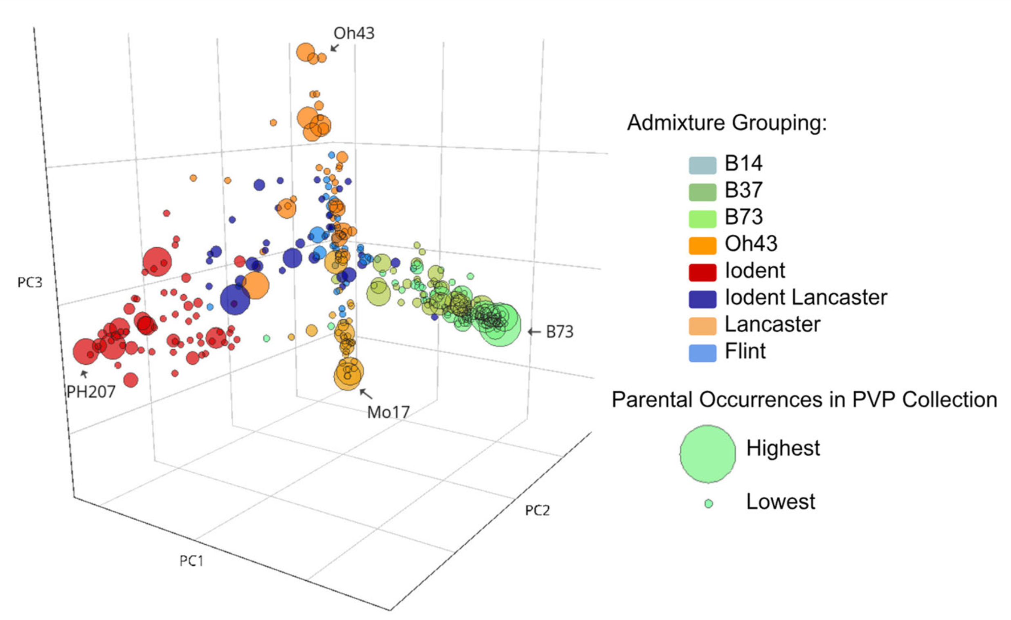
21
Hybrid breeding is usually organized with two or more mutually heterotic pools.
I recently had a discussion about heterotic gene pools. A team is working on gradually dividing the material of one gene pool into two such pools. However, the specific purpose was to improve the use of heterosis in synthetic varieties. What do we think about this? As a rule, seed of synthetic varieties is sold in a generation after Syn-2 or Syn-3, i.e. close to HWE. Hence, splitting and subsequent reunification of the material does not lead to an increase in heterozygosity. This goal can actually only be achieved by breeding Interpool hybrids. Hm ... Really? Is there no option to profit from the allele frequency difference between pools for synthetic populations?
White, Mike,de Leon, Kaeppler, 2020: Crop Science. 2020:100-114. 3D plot visualizes gene-tic distances based on appr. 900.000 SNPs of a historical maize panel. Germplasm pools are e.g. Flint, Io-Dent, Lancaster.
Stelling, 1995, Plant Breeding 114, 61-65. Have you heard about ‘Chance Hybrids’? Mix two inbred lines of an outcrossing perennial crop, harvest for instance 50% seed as (the two reci-procal) hybrid and 50% seed as ‘selfed’ seed and sow this as Chance Hybrid. It was repeatedly observed that the hybrid plants outcompeted the inbred plants and ‘soon’ what grew in the field was almost indistinguishable from a pure hybrid. Well, a chance hybrid is not really a synthetic population. We could instead mix two self-incompatible genotypes, their mixture would not show selfing, the offspring (again both reciprocal F1s) would be purely hybrid. The production would not be like hybrid seed production: both parents are father and mother and there is nouse of gametozide nor male sterility or the like. Well, one small ;-) annoying question is: How to propagate and maintain an inbred line if the material is self-incompatible. Hm ... Alternatively, one could grow the seed mother with marked numerical inferiority and the pollinator in stark preponderance, such as 1:9. Then most seed harvested from the seed-mother would be hybrid. This could be feasible if the seed yield from a small portion of the seed production field (such as 10%) is sufficient to generate revenue; that is, if the species produces very many seeds per seed mother plant. Maybe Brassica rapa could be taken as model, with maybe >1000 seeds har-vested per plant. This rather inefficient method of seed production (pollinator in numerical preponderance) might, perhaps, be conceivable. After all, the harvest from the pollinator area would still be usable as “normal” turnip production.
Still, in a ‘normal’ synthetic population, the separation of the germplasm pool into two mutually heterotic pools and the subsequent employment of one line from pool A and one line from pool B to create Syn-0, S-1, and so on, this would not produce the desired effect (increased heterozy-gosity and heterosis). The number of components is too low, only half of the heterosis would be exploited. Even if such as six pools were established, the appeal of hybrid breeding, as shown on the previous pages, would not be realised, it would not be better than finding these six lines in the initial, one, big, common germplasm pool.
Is anything speaking against separate pools, more than (waste of) effort? The separation of pools makes it more difficult to breed for gene combinations which show positive, favourable epistatic effects. Genes which are good if being together can not show this if they are separated in distant pool. Well, may be this is not a strong point.

Slide 22
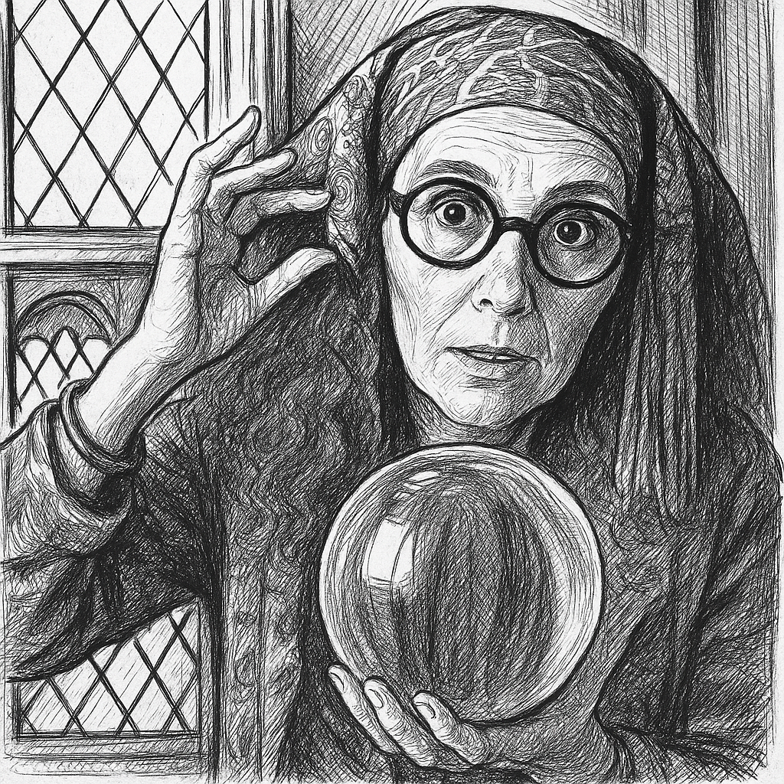
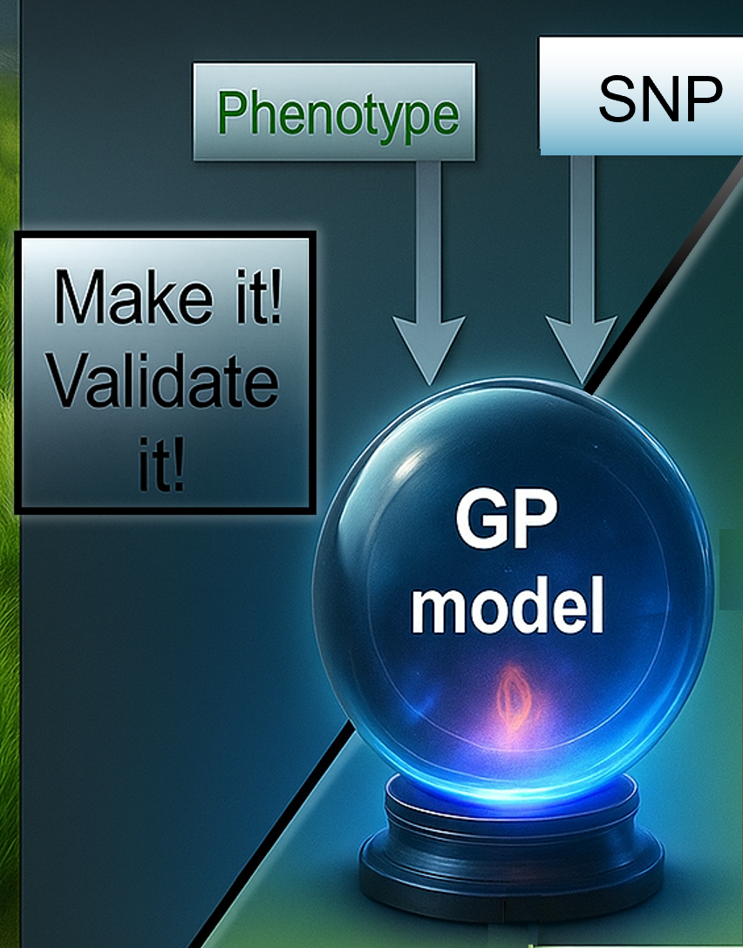
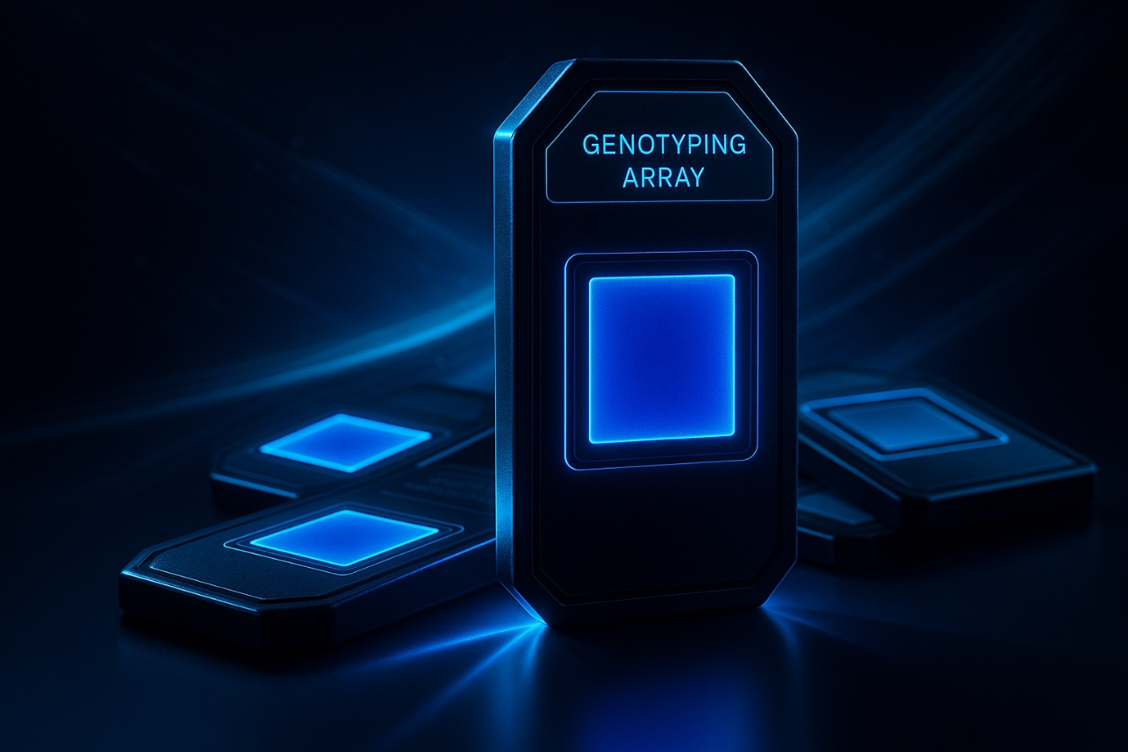
From the appre-ciaton of Distance as ignition for Heterosis we go now to an appre-ciation of Predic-tion - to save bud-get and time; to increase efficien-cy of Breeding.
22

Slide 23
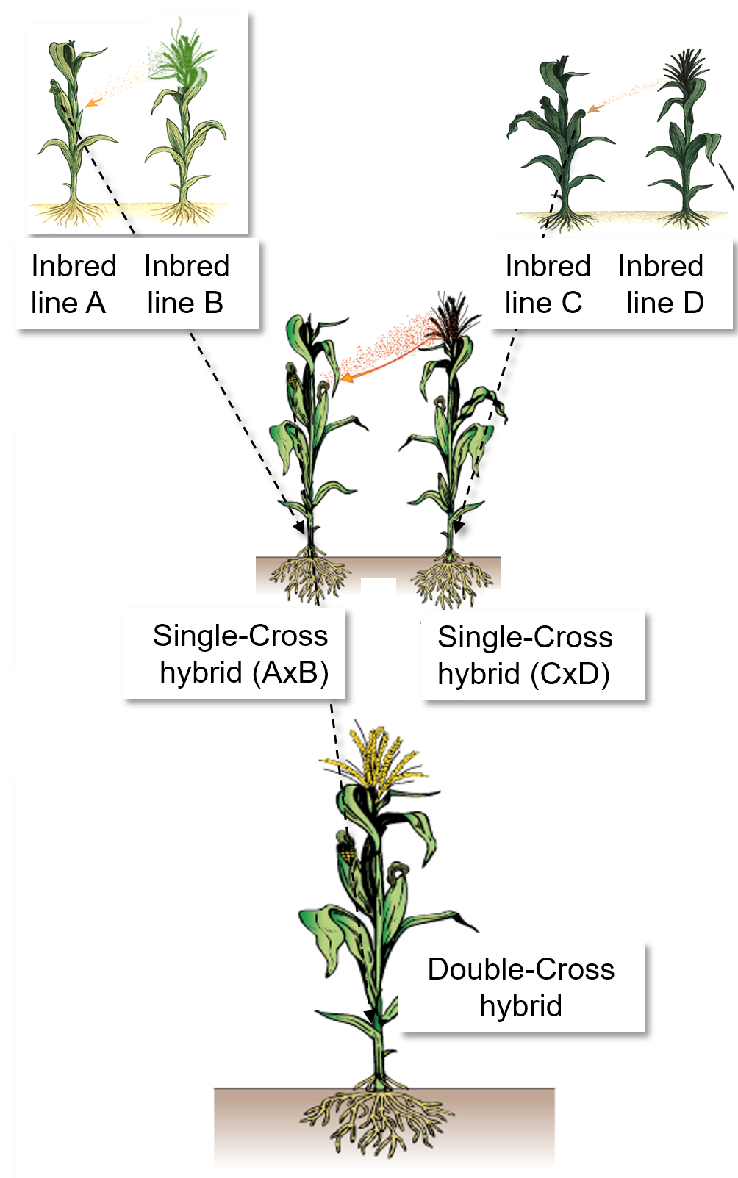
Inspired by
https://www.grassrootsglobal.net/mer2023/schedule/7.1 _Handout_Joshi2.pdf
In the early phases of corn hybrid breeding, Inbreeding Depression was very large, inbred lines performed very poorly.
Hence, producing single-cross hybrids was not a practical option. The low yield of inbred lines used as seed mother would have made the cost of seed prohibitively high. In the past, such seed for single-cross hybrids was therefore used only as a first step, adding one additional multiplication stage before reaching the scale of certified seed for farmers. Instead of producing hybrids ‘directly’, seed for Double-Cross cultivars (4-way hybrids) was produced: One single-cross served as seed parent, and a second single-cross as pollen parent. Since both parents were F1 hybrids, they were highly productive. This system allowed the limitations of the first step to be compensated for by the high efficiency of the second step, making farmer-ready seed cheaper, affordable.
The drawbacks? More plots (and one additional season) with isolation in space were needed to maintain the four lines and conduct the first-step crosses. Selection intensity was reduced: A third-best and fourth-best line was needed instead of using only the best-plus-second-best line.
Since about 1960, better inbred lines were developed, many yielding even up to half of a hybrid, therefore meanwhile seed for Single Cross Hybrids can be economically produced and sold.
23

Slide 24
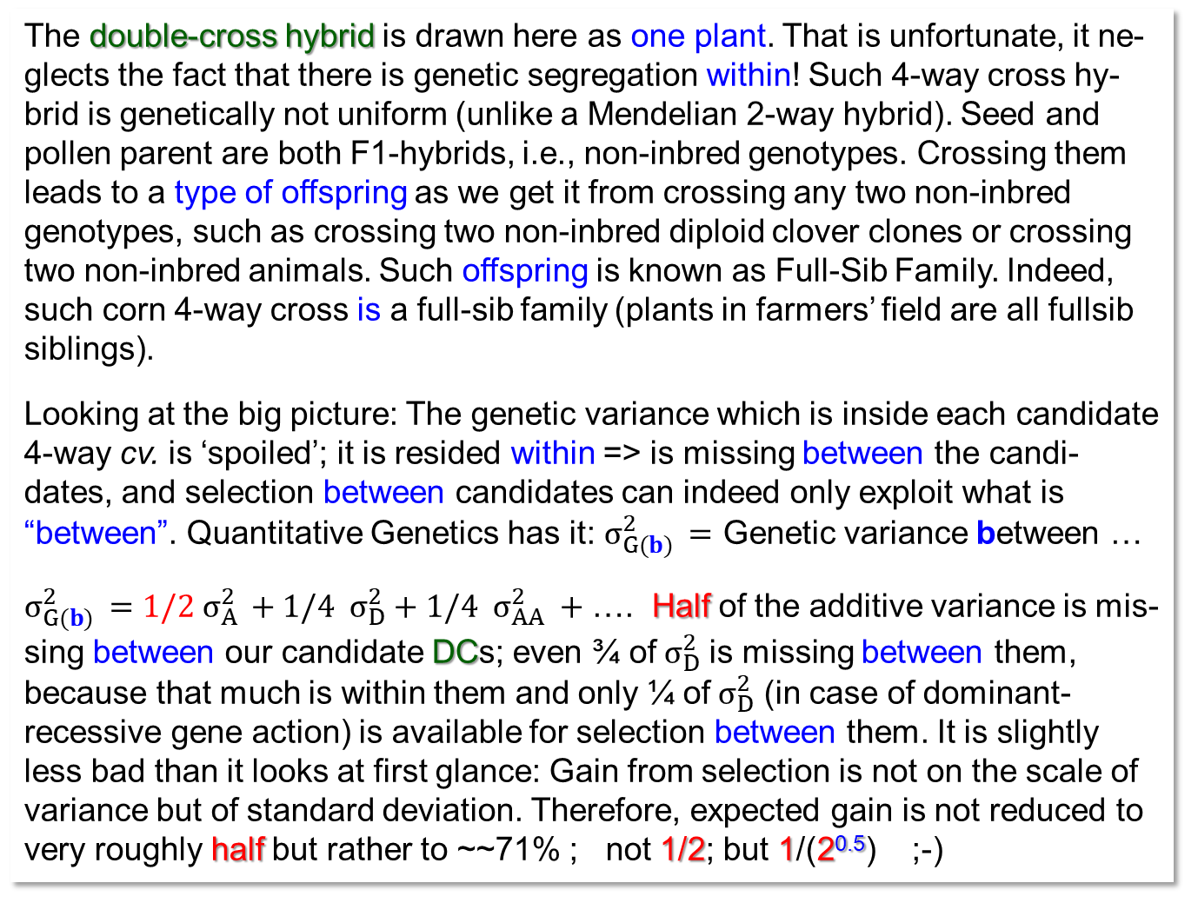
24
Doubles aka double-cross hybrids (DC) aka 4-way cross hybrids …
The double-cross hybrid is drawn here as one plant. That is unfortunate, it ne-glects the fact that there is genetic segregation within! Such 4-way cross hy-brid is genetically not uniform (unlike a Mendelian 2-way hybrid). Seed and pollen parent are both F1-hybrids, i.e., non-inbred genotypes. Crossing them leads to a type of offspring as we get it from crossing any two non-inbred genotypes, such as crossing two non-inbred diploid clover clones or crossing two non-inbred animals. Such offspring is known as Full-Sib Family. Indeed, such corn 4-way cross is a full-sib family (plants in farmers’ field are all fullsib siblings).
Looking at the big picture: The genetic variance which is inside each candidate 4-way cv. is ‘spoiled’; it is resided within => is missing between the candi-dates, and selection between candidates can indeed only exploit what is “between”. Quantitative Genetics has it: $σ_{G(b) }^{2}=$ Genetic variance between …
$σ_{G(b) }^{2}=1/2 σ_{A }^{2}+1/4{ σ}_{D}^{2}+1/4{ σ}_{AA}^{2} +$…. Half of the additive variance is mis-sing between our candidate DCs; even ¾ of${ σ}_{D}^{2}$ is missing between them, because that much is within them and only ¼ of${ σ}_{D}^{2}$ (in case of dominant-recessive gene action) is available for selection between them. It is slightly less bad than it looks at first glance: Gain from selection is not on the scale of variance but of standard deviation. Therefore, expected gain is not reduced to very roughly half but rather to ~~71% ; not 1/2; but 1/(2^{0.5}) ;-)
With ChatGPT

Slide 25
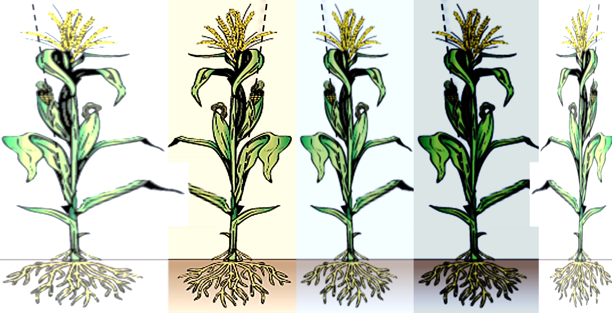
Things will become even-clearer after studying the Quantitative Genetics Chapters ;-)
The genetic heterogeneity inside each DC hybrid is, depending on setting and policy, read as advantageous or a disadvantage.
Heterogeneous cvs. are harder to phenotypically distinguish from each other than homogeneous cvs. (yet, the law says, cvs. must be distinct – remember ‘DUS’). For heterogeneous cvs., it might be less easy to find the optimum date to apply fertilizer, fungicide, herbicide et cetera than for a homogenous cultivar; similar for harvesting date. Quality of product may be an issue, if it is e.g. an onion hybrid cultivar and the consumer insists that each onion bulb should look exactly like the other ...
Heterogeneity may be desirable. Organic breeders and farmers are deeply convinced: Diversity, i.e, heterogeneity, helps to alleviate many problems (ISBN: 978-0-470-95858-2; DOI 10.21142/SS-0102-2020-013); especially if the threat is a (fungal or viral) disease. In such cases, indeed, the genetic he-terogeneity of resistance and tolerance can significantly slow down an epide-mic and reduce the yield losses caused by the attack.
Ponder the difference between (1) Genetic Diversity that allows instant reaction of a crop community to stress (in the sense of ‘Reaction Norm’) and (2) Genetic Diversity as condition for genetic adaptation (‘micro-evolution’) to local (agro-ecological) conditions. For the latter, seed must not be traded but the cv. has to go through its ‘micro-evolution’ on that spot, farm, environment.
25
DOI: 10.2135/cropsci2007.03.0170

Slide 26
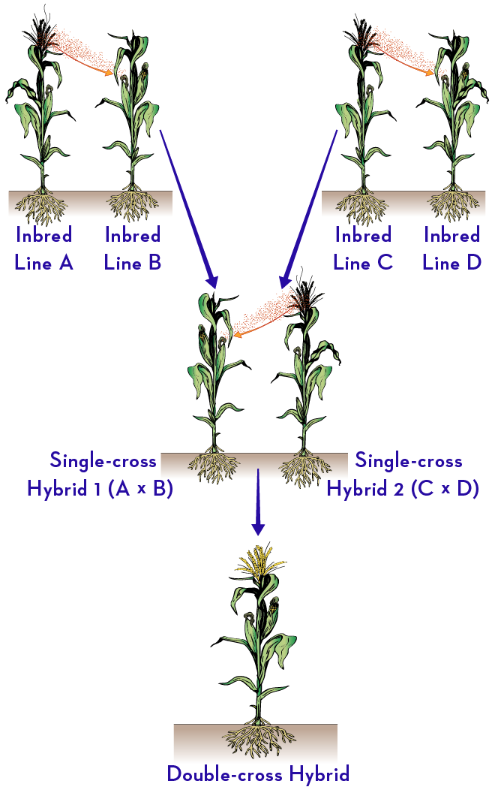
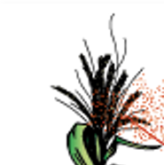
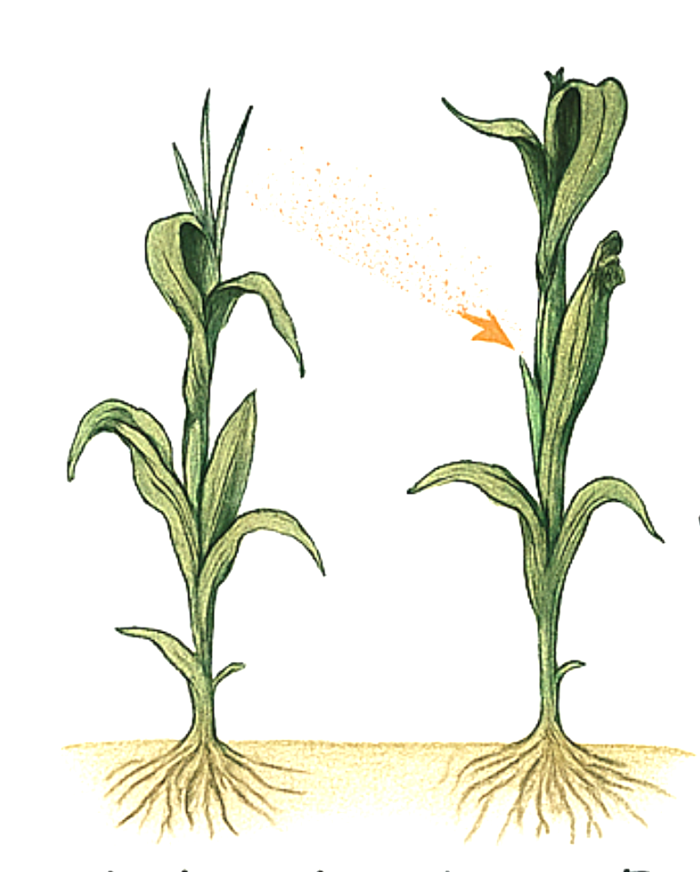
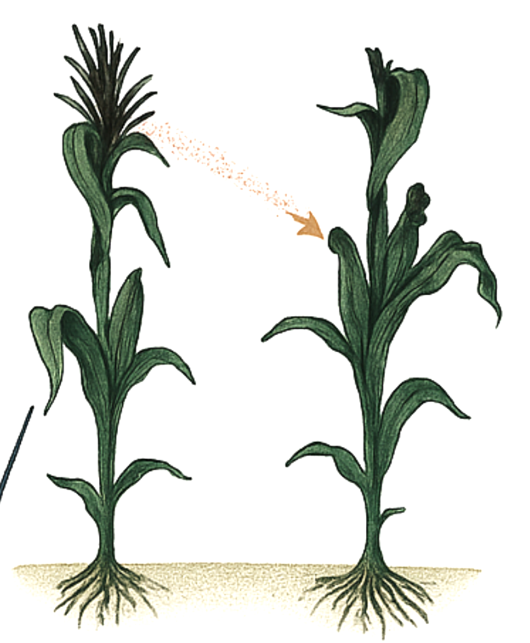
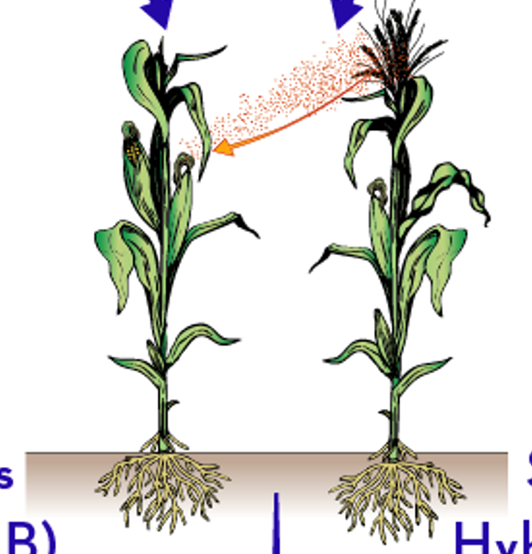
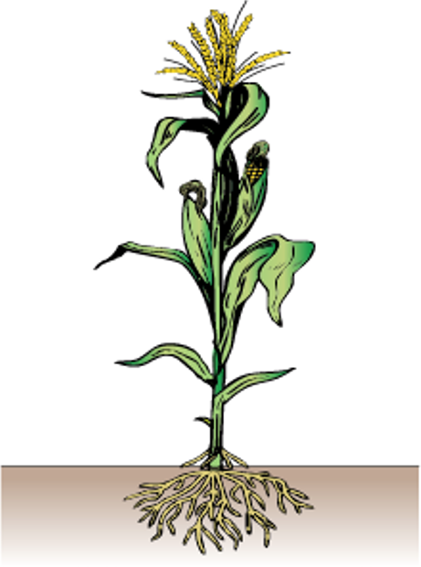
t/ha
Examples for yield performance in
Mind: F1(AxB) and F1 (CxD) exploit ‚only‘ the within-genepool heterosis,
whereas ...
... the DC hybrid F1[(AB)x(CD)] exploits the (larger) between-genepool heterosis.
Inbred Inbred
line A line B
Inbred Inbred
line C line D
2
3
3
1
Single-Cross
hybrid (AxB)
Single-Cross
hybrid (CxD)
6
5
Example for two mutually heterotic gene-pools:
Left side: Dent
Right side: Flint
DOI 10.2135/cropsci1992.0011183X003200060001x
Double-Cross
Hybrid
AxB x CxD
9 t/ha
26
https://nrcca.cals.cornell.edu/crop/CA4/PO-17DoubleCrossHybrid.jpg

Slide 27
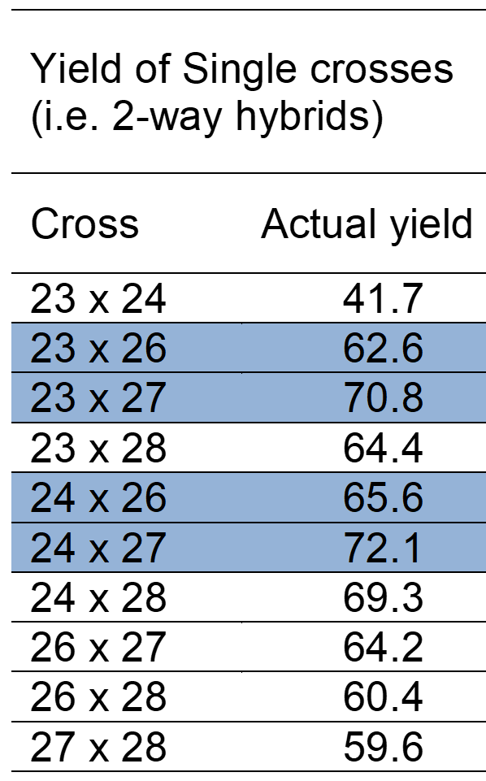
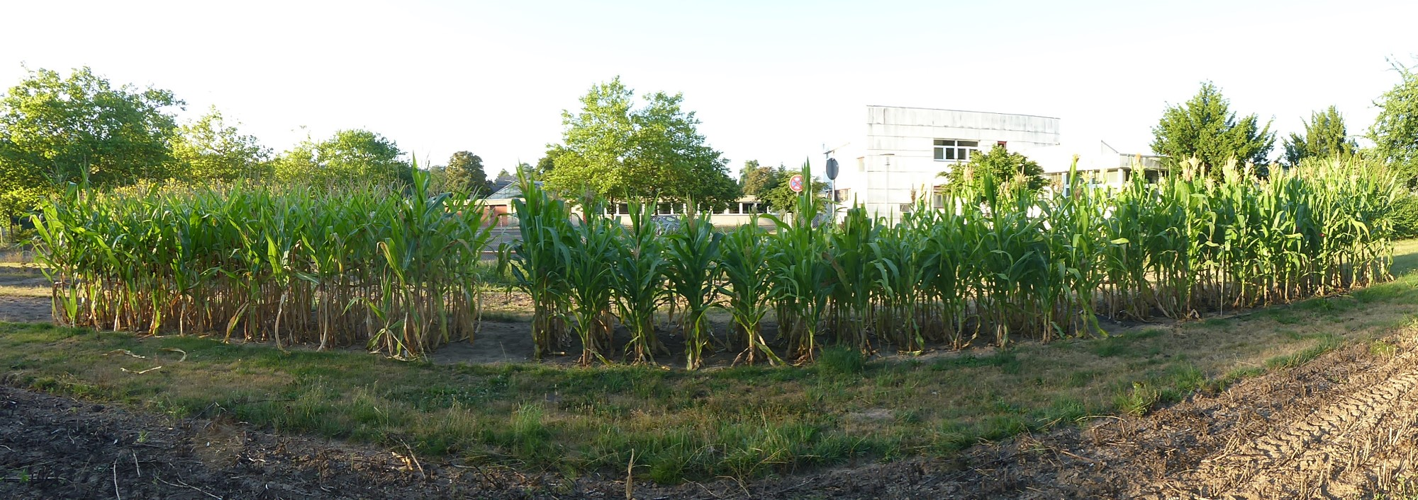
What is the expected yield of the 4-way hybrid (23x24) x (26x27)?
See one locus per basic inbred line. Gametes that come from the hybrid F1(23x24) are either carrying the allele A1 or A2, and they can mate with gametes that carry A3 or A4 - but not with A1 and not with A2. Offspring from our cross can not ‘again’ contain A1A2; nor A3A4*.
*and of course not A1A1;A2A2;A3A,:A4A4
27
© SY

Slide 28
What is the expected yield of the 4-way hybrid (23x24) x (26x27)?
28
See one locus per basic inbred line. Gametes that come from the hybrid F1(23x24) are either carrying the allele A1 or A2, and they can mate with gametes that carry A3 or A4 - but not with A1 and not with A2. Offspring from our cross can not ‘again’ contain A1A2; nor A3A4*.
Predict the performance of the 4-way hybrid (23x24) x (26x27) as average of those four crosses (combinations) which are member of the six possible crosses between four lines - and which are not the 4-way hybrid’s parents. The six crosses are: F1(23x24), F1(23x26), F1(23x27), F1(24x26), F1(2x27), F1(26x27). Calculate accordingly: Our 4-way cross is predicted as Y = ¼ (62.6+70.8+65.6+72.1) = 67.78
Epistasis is the result of interaction between genes at different loci. Neglecting epistasis means that we (naïvely) add up the effects at different loci. Our prediction here, valid for one focal locus, is indeed valid genome-wide if Epistasis can be neglected. Yet: With more than one locus and with non-zero epistasis,
things may change (a little bit, because usually epistasis is not of primary importance).
*and of course not A1A1;A2A2;A3A;A4A4

Slide 29
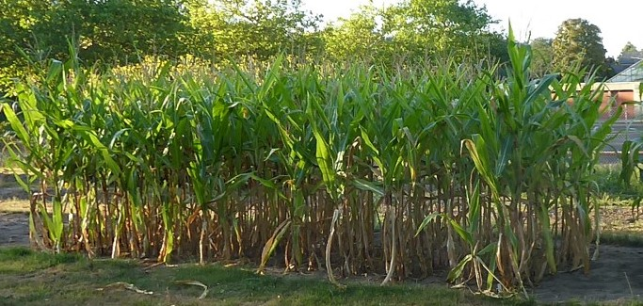
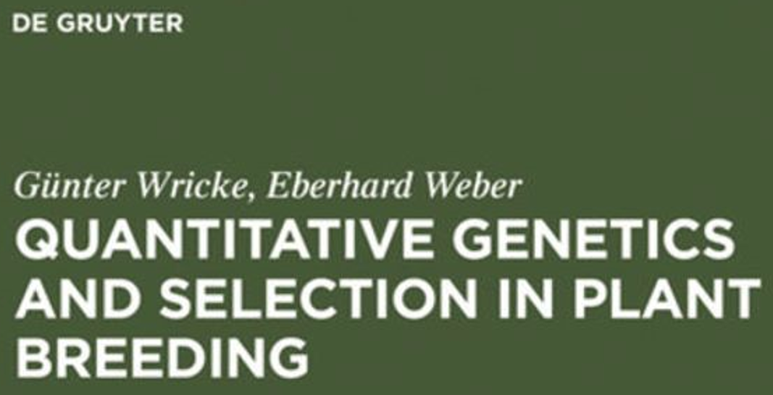
© SY
https://doi.org/10.1515/9783110837520
29

Slide 30
See yield data from decent field trials: From single cross hybrids and ‘their’ DC)
2-way hybrids data was used to predict yield of all 15 possible 4way cross hybrids (DC). These 15 DC were field-tested to validate the prediction. The last column shows the small differences between predicted and realized yield. Again: Differences were rather small ☺.
It goes without saying: The ten 2W hybrids and the 15 4W hybrids were grown in the same experiment. Breeders, however, must predict from their current seasons to future season. Hm ...
© SY
https://doi.org/10.1515/9783110837520
30

Slide 31
The Prediction as shown in the last page, now judged via correlation coefficient rather than via direct difference.
72
Correlation was very high . R² = 0.79, means that 79% of the phenotypic variation between the realized 4W was explained by the variation of the predicted 4W data.
r=0.889**
70
68
66
64
Actual yield of double-cross hybrids
62
60
58
56
https://doi.org/10.1515/9783110837520
56
58
60
62
64
66
68
70
72
Predicted from Single-Cross hybrid data
31

Slide 32
A different approach to prediction. Here, not the 10 2-way hybrid data was used but the five GCA-values of the five lines.
72
r=0.382n.s.
Each 4-way hybrid was predicted from the mean of the pertinent 4 GCA-effects.
F1(23-24)x(26x27) = ½ (GCA_{2.3}+GCA_{2.4}+GCA_{2.6}+GC_{2.7})
= F1(23-26)x(24x27) = F1(23x27)x(24x26) hm …
By the way, why is it ½ and why not ¼? hm ...
You see: The predicted performances were calculated using the GCA data yet ignoring SCA. Therefore, those three 4W hybrids which are based on the same set of four lines showed the same three predicted values (three red, blue, black, violet, green, respectively). Yet, the actual three 4W-hybrids differed, probably mainly due to different SCA effects realized (of course due to experimental error, too).
The correlation was correspondingly quite low. Yet, again, on the other side, GCA is much cheaper to get than SCA (‘get SCA’ means to test all the 2-way hybrids that can be made from a set of lines; that is expensive indeed).
70
68
66
64
Actual yield of double-cross hybrids
62
60
58
56
56
58
60
62
64
66
68
70
72
Predicted from GCA effects
https://doi.org/10.1515/9783110837520
32

Slide 33
Let us imagine a second* locus for these four inbred lines. A blue locus, a red one.
33
We used yield data of four single cross hybrids as basis for prediction – one of those four is e.g. the cross between line 23 and line 24. In that single cross hybrid, as example, all individuals are A1A2 / B1B2 / C1C2 / D1D2 … and so on for all heterozygous loci. But when crossing F1(23x24) with e.g. F1(26x27), offspring from crossing are not only the four grey-indicated cells (see bottom left) but all the 16 combinations. The A1A3 heterozygote may be B1B3-heterozygous at the second locus as well as B1B4, et cetera et cetera.
If – well, if, as an example, … if the genetic impact of the 1-locus genotype A1A3 on the trait is different in case of being accompanied by the 1-locus genotype B1B3 instead of by B1B4, well, then it makes a difference!
Then! ... the prediction of the here-considered 4-way hybrid as average only of the four grey 2-way hybrids was naïve.
Reason: Then ... we neglected Epistasis – you knew it already, true?
*You of course know that you have to – as you ponder this topic – imagine more than 2 loci, yield is polygenic, poly means many.

Slide 34
Find out by yourself; predict yield of corresponding three-way hybrids!
3-way hybrids can be predicted in a similar way from either GCA alone or from data of ‘their’ 2-way hybrids, and again we have the question whether Epistasis needs to be con-sidered. You will want to find out how and hence complete the table by yourself. Data from realized yields of such 3-ways are alas, not available in this source.
When predicting such non-homogeneous hybrids (3-way, 4-way) from homogeneous hybrids (2-way), we of course neglect (in addition to Epistasis) the potential effects of such crop-stand-heterogeneity. There may be competition within non-homogeneous hybrids between their somewhat different individuals; this may be different from the competition effects among ‘same’-genotype individuals in homogeneous (2-way cross) stands.
© SY
If you divide anything by 3 here, then you are on the wrong track ;-)
DOI 10.1515/9783110837520
34

Slide 35
The entire panel of all 2-ways which could be produced from a set of inbred lines: Would it - for its panel mean performances - differ from the mean of all 3-ways or all 4-ways (that alternatively could be produced from the same set of inbred lines)?
panel mean performances
In other words: We ask whether 2-ways, 3-ways or 4-ways differ from each other as group, if being bred from the same panel of lines.
We already saw: Whether we look at the panel of (all) inbred lines or at the panel of (all) possible hybrids, they come from the same array of gametes and they give that same array of gametes (assume: LD=0).
We have no change due to Selection, Mutation, Drift, Migration. Allele frequency stay constant. ¿Todo claro?
35

Slide 36
Will 2-ways, 3-ways, 4-ways differ from each other, taken as group, bred from the same Basic Pool of lines (or gametes)? Think for yourself! Derive it independently!
If there was no Selection, Mutation, Migration, Drift, Magic … then the frequency of the alleles such as A1 did not (can not) change.
The sum-of-all inbred lines produce the same gametes, in same frequency as the sum-of-all SC hybrids.
A 3-way hybrid results from mating gametes from single cross hybrids with gametes from inbred lines. If you produce all possible three-way-hybrids, then you must mate all inbred lines with all single cross hybrids: i.e., you mate the ga-metes of the inbred lines with the gametes of the single cross hybrids, all with all. As (all) lines give the same gametes as (all) SC hybrids .. you see that all 3-way hybrids together, as group, contain the same genotypes that make the group of SC hybrids (and, go on, that make the group of all 4-way cross hybrids; of course).
All available inbred lines
All available 2-way F1
All available 3-way F1
All available 4-way F1
All gamete types
This result is as it must be. Only the mating system changed: Selfing for maintenance of the lines, i.e. the population at homozygosity. Crossing for getting the types-of-hybrids, the population at zero-inbreeding. With this change alone, no change of allele frequency or gamete (haplotype) frequency is expected.
An important point to understand is: Not all 2-ways are fully heterozygous, some are such as A2A2_B1B2 ; some of the 3-ways are not like backcross (A1A2_B1B2) x (A1A1_B1B1) but are such as (A1A1_B1B2) x (A2A2_B1B1); and so on.
36

Slide 37
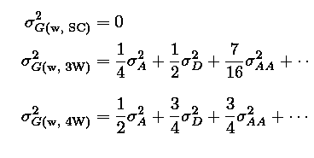
Will the total of all 2-ways differ from the total of all 3-way hybrids or 4-way hybrids (from same inbred lines)? Now: Variance between the members of these three groups.
There are differences between these three types of hybrids groups, indeed!
There is a different amount of genetic variance within
► a single cross hybrid compared to
► a three-way cross hybrid compared to
► a four-way cross hybrid
There is zero variance within SC-hybrids, hence all genetic variance (we are at zero inbreeding) is between them.
There is a bit of variance within each 3-way cross F1, because one of the two parents segregated.
That much of genetic variance is missing between the 3-way hybrids.
There is a bit more genetic variance σ²_{G(w)} within each 4-way cross F1, because both parents segregated. The variance inside each such 4-way is as large as in each ‚normal‘ group of full-sib siblings. This is what a 4-way hybrid is: The offspring from mating to unrelated non-inbred genotypes (Mother, Father).
These features can be quantified by Quantitative Genetic Theory (ISBN: 9780191868986; ebook); SC=2-way=single cross, 3W=three-way, 4w= four-way).
w
w
w
37

Slide 38
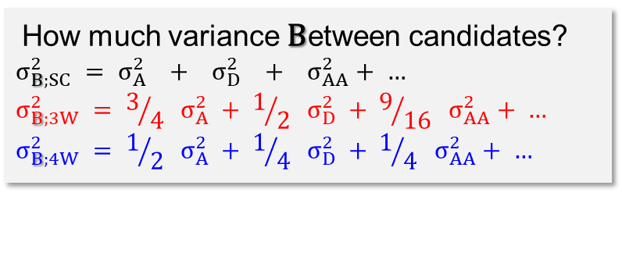
„All“ single-cross-hybrids, „all“ 3-way hybrids and „all“ 4-way hybrids (that can be bred from a common panel of inbred lines). Same Average yet Different Variance (between the members of each of the three types-of-hybrids)
Take note: The three curves do not show one hybrid per curve.
Instead, each curve shows all (the endless-many) hybrids per hybrid-type that could be bred from a given panel of inbred lines (representing a given germplasm; genepool; population).
„Best“ SC is better than „best“ 3W, which is „better“ than best „4W“.
This is because with more variance, best is ‚better‘ than with less variance. See: Having chosen the two ‚best‘ lines to make the best SC, adding the third-best line to make the best 3W is not improving anything; and adding the 4th-best line to make the best 4W is, again, rather reducing the performance of the resulting candidate.
How much variance Between candidates?
$$σ_{B;SC}^{2} = σ_{A}^{2} + σ_{D}^{2} + σ_{AA}^{2}+ …$$
$$σ_{B;3W}^{2} = 3/{4 } σ_{A}^{2} + 1/{2 } σ_{D}^{2} + 9/{16 } σ_{AA}^{2}+ …$$
$$σ_{B;4W}^{2} = 1/{2 } σ_{A}^{2} + 1/{4 } σ_{D}^{2} + 1/{4 } σ_{AA}^{2}+ …$$
N.B. Difference between best SC and best 3W is slightly smaller than difference bet-ween best 3W and best 4W. This is because in case of 3W, there are two lines with a 25% share and one with a 50% share ...
Best 4W
Best 3W
38
Best SC
Single Cross Hybrids
3-Way hybrids
4Way-hybrids
30
40
50
60
70
... Therefore, by appropriate choice, the result can be slightly improved. In case of a 4W, each line contributes 25%: no option for such choice, no option to slightly improve the result.

Slide 39
From here you may go to UNPLAB-CorrTraits:Ch-1[IndirSel]
What did we study in this chapter?
Judge the genetic variance in a population, as it depends on whether the population is more or less inbred (all else to be same).
Effect of either crossing two population or mixing-and-random-mating them.
Concept of more-than-2-way hybrids, i.e. 3-ways and 4-ways.
There are too many options, much too many different 3-way and 4-ways that could be bred based on a set of inbred lines (see UNPLAB-BrMeth_Ch-4[GCAII]; page ~19);
therefore we need to predict and then focus only on the best-predicted ones. We will create seed (breed, cross, produce such seed for field-testing) only for them.
You saw how the classical prediction (based on phenotypic data) works, cheap with GCA only, more effort with GCA plus SCA*, we discussed some of the imponderables (Epistasis, effects of genetically non-homogeneous crop stands).
*If you use results from SC hybrids, you implicitly use GCA-plus-SCA, even if you maybe cannot always estimate the two parameters separately. Clear, is it? And ... if you use SCA data, then you have GCA data available anyway, I do not see how you could have SCA estimates and not having GCA anyway. “I use only SCA data” is therefore probably a non-sense statement.
39

